Slide 1
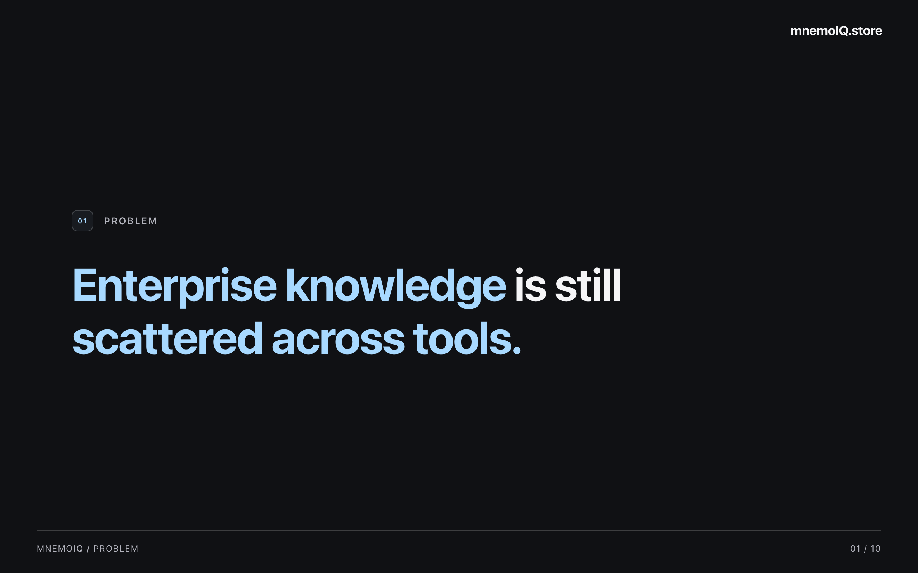
Notes:
Our work knowledge lives across separate tools. An answer may sit in a ticket, a code change, or a conversation. Teams spend time piecing these fragments together. That is the problem mnemoIQ addresses. Pause, then explain what this costs engineers.

Slide 2
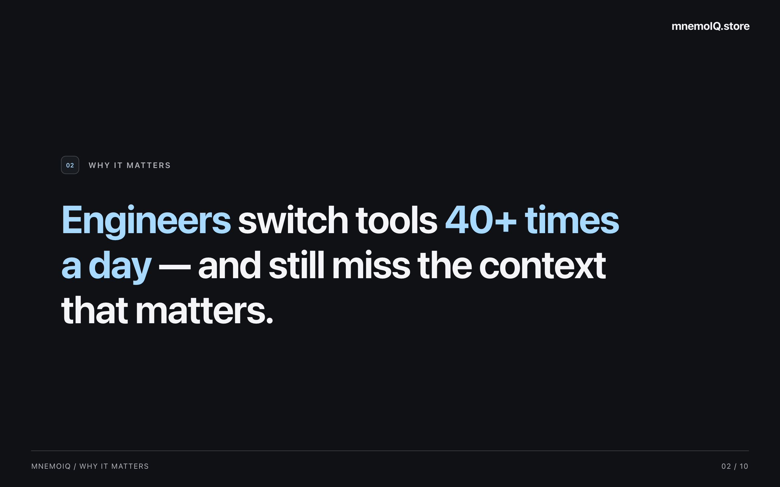
Notes:
Engineers repeatedly switch tools to find the context they need. Each switch interrupts their work, and an important detail can still be missed. The key point is the time and attention this takes. Move to how mnemoIQ brings that context together.

Slide 3
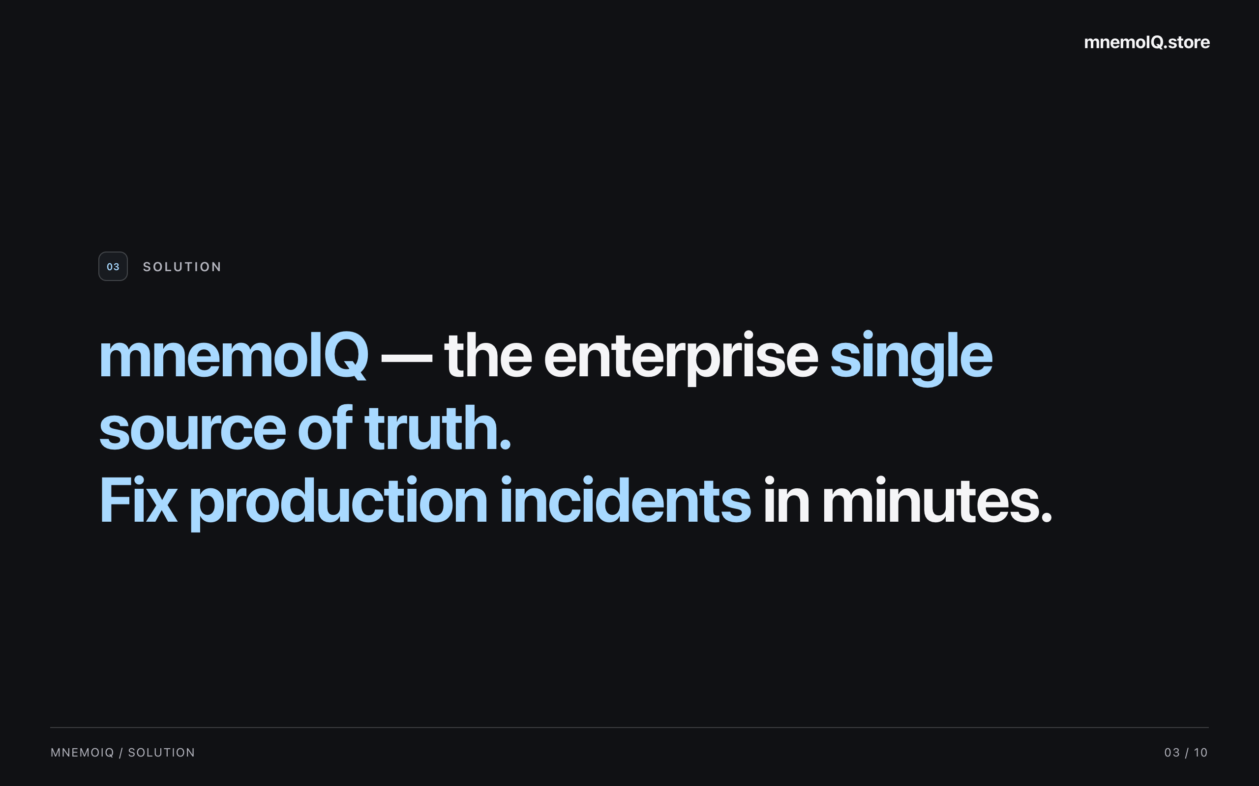
Notes:
mnemoIQ brings connected enterprise knowledge into one place to help teams find answers. During an incident, the aim is to find useful context quickly so engineers can focus on the fix. Next, walk through a familiar production problem.

Slide 4
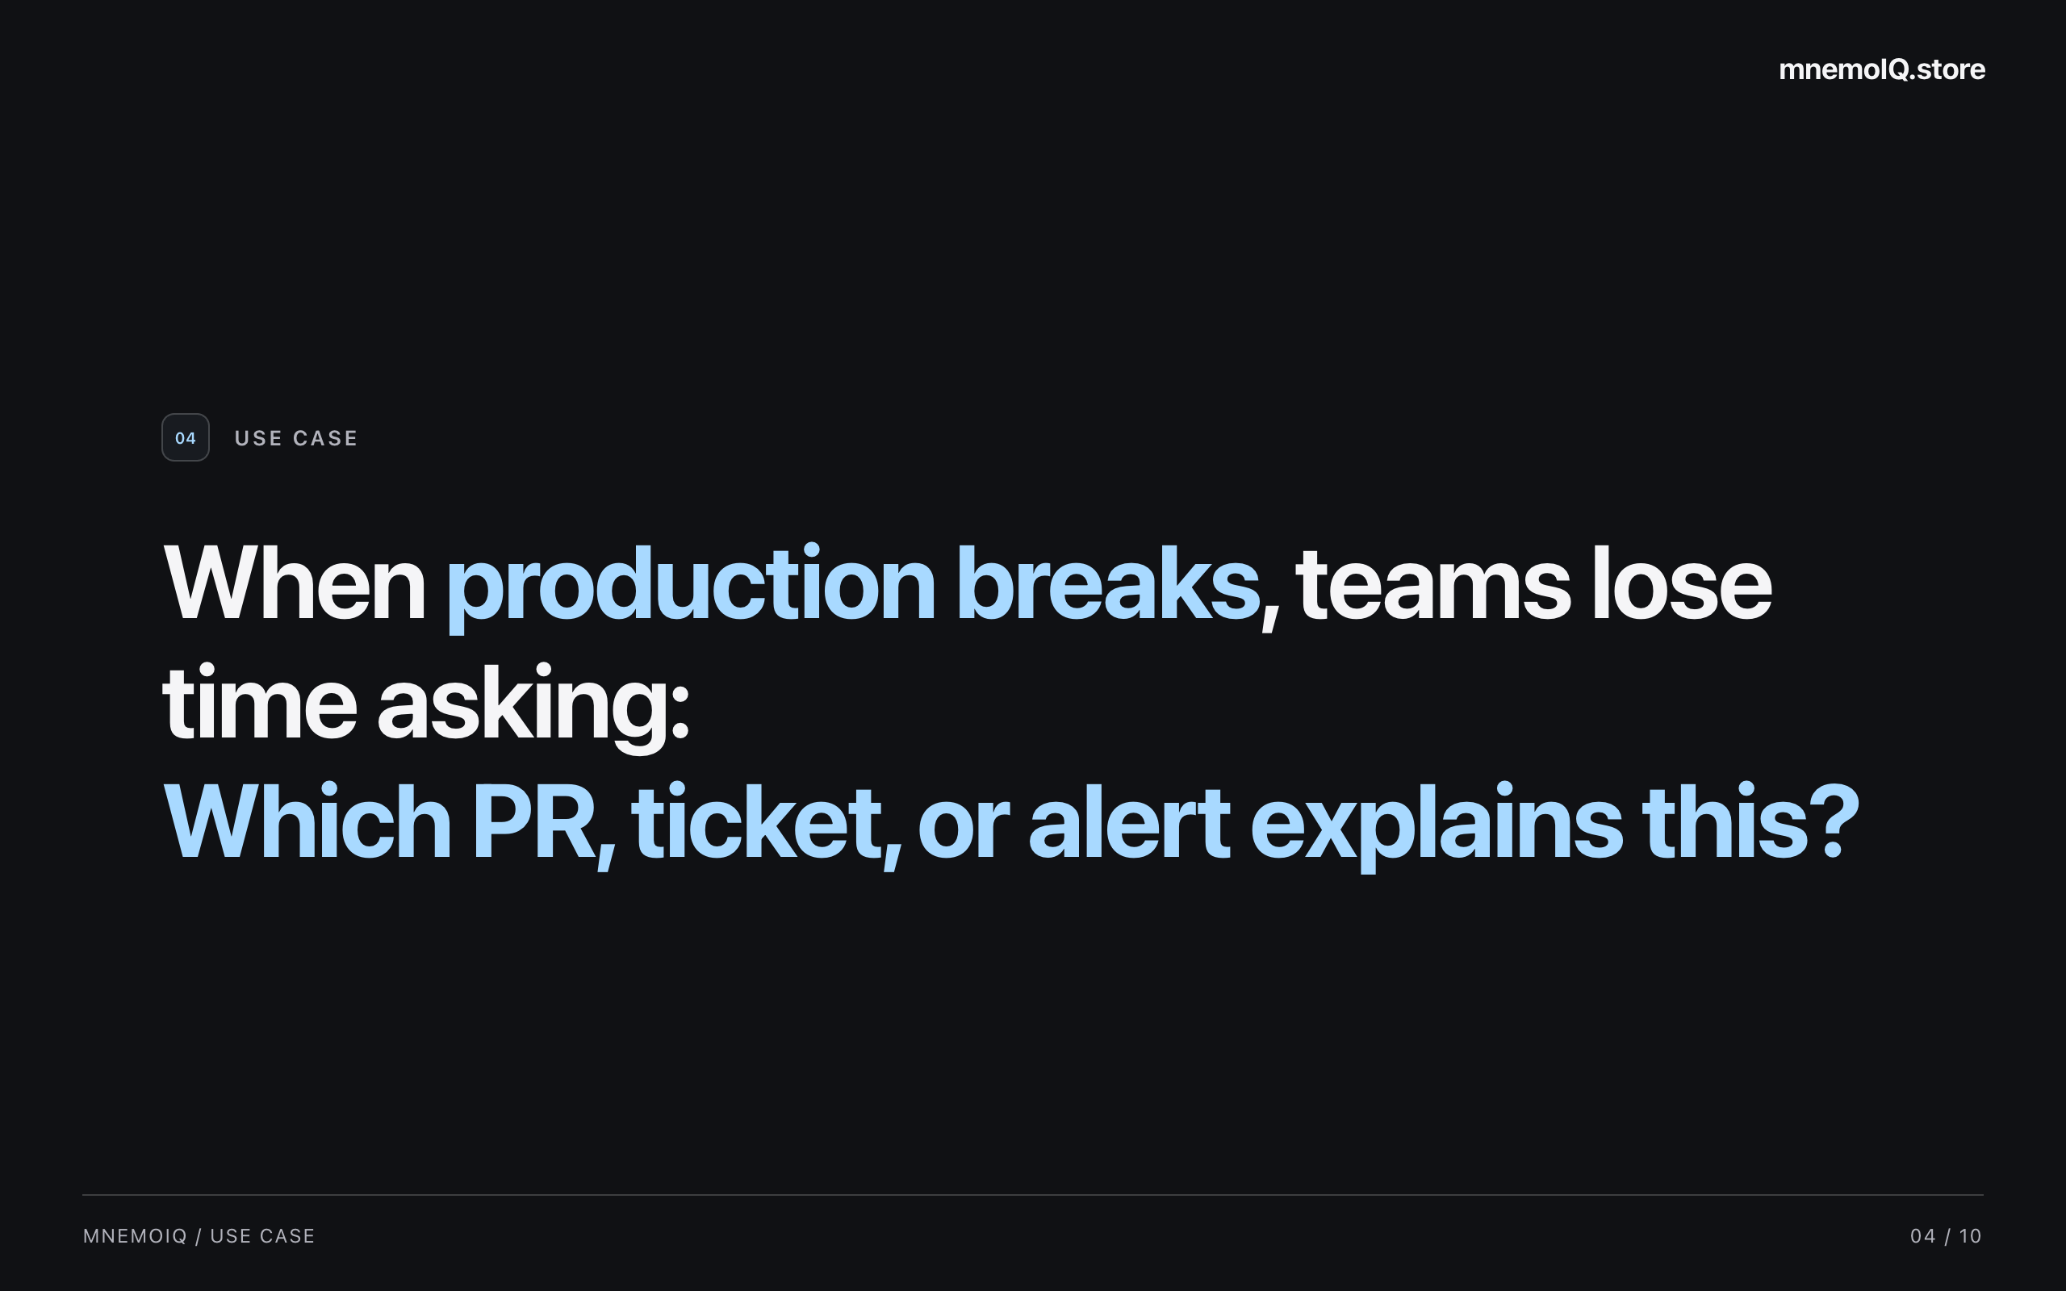
Notes:
Imagine production breaks after a recent change. The team needs to connect the alert to the relevant pull request and ticket. Today, that can mean searching several tools and asking colleagues. mnemoIQ helps bring those clues together. Introduce Olivia as the way to ask for help.

Slide 5
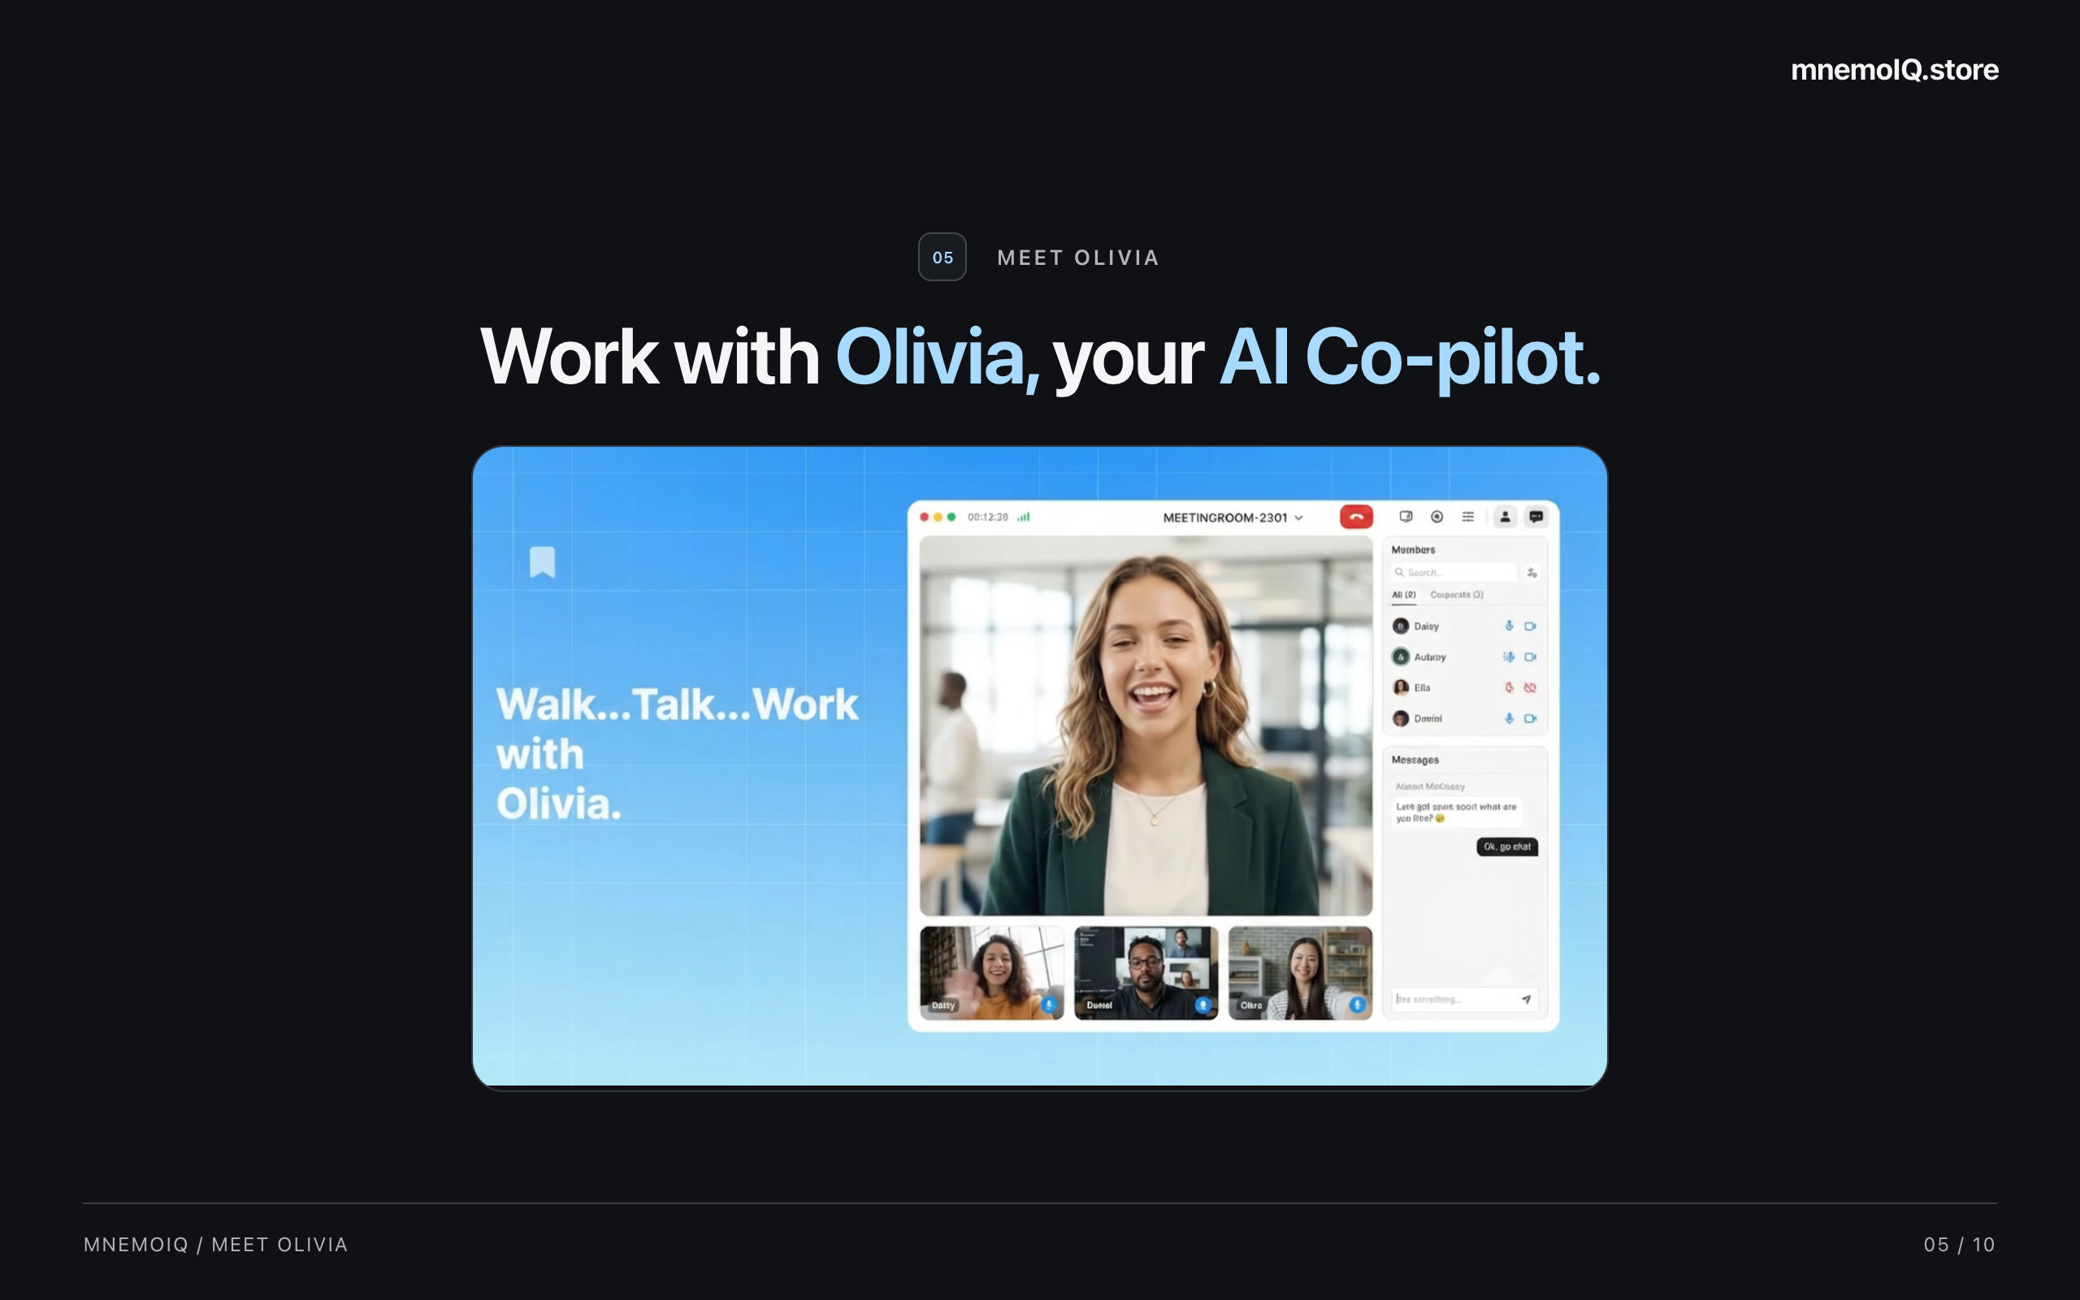
Notes:
This is Olivia, the AI assistant in mnemoIQ. Ask her questions using your connected workspace context. Click her image to open the video, then return to the deck. Voice sessions and workspace connections require setup. Next, explain the controls available to the team.

Slide 6
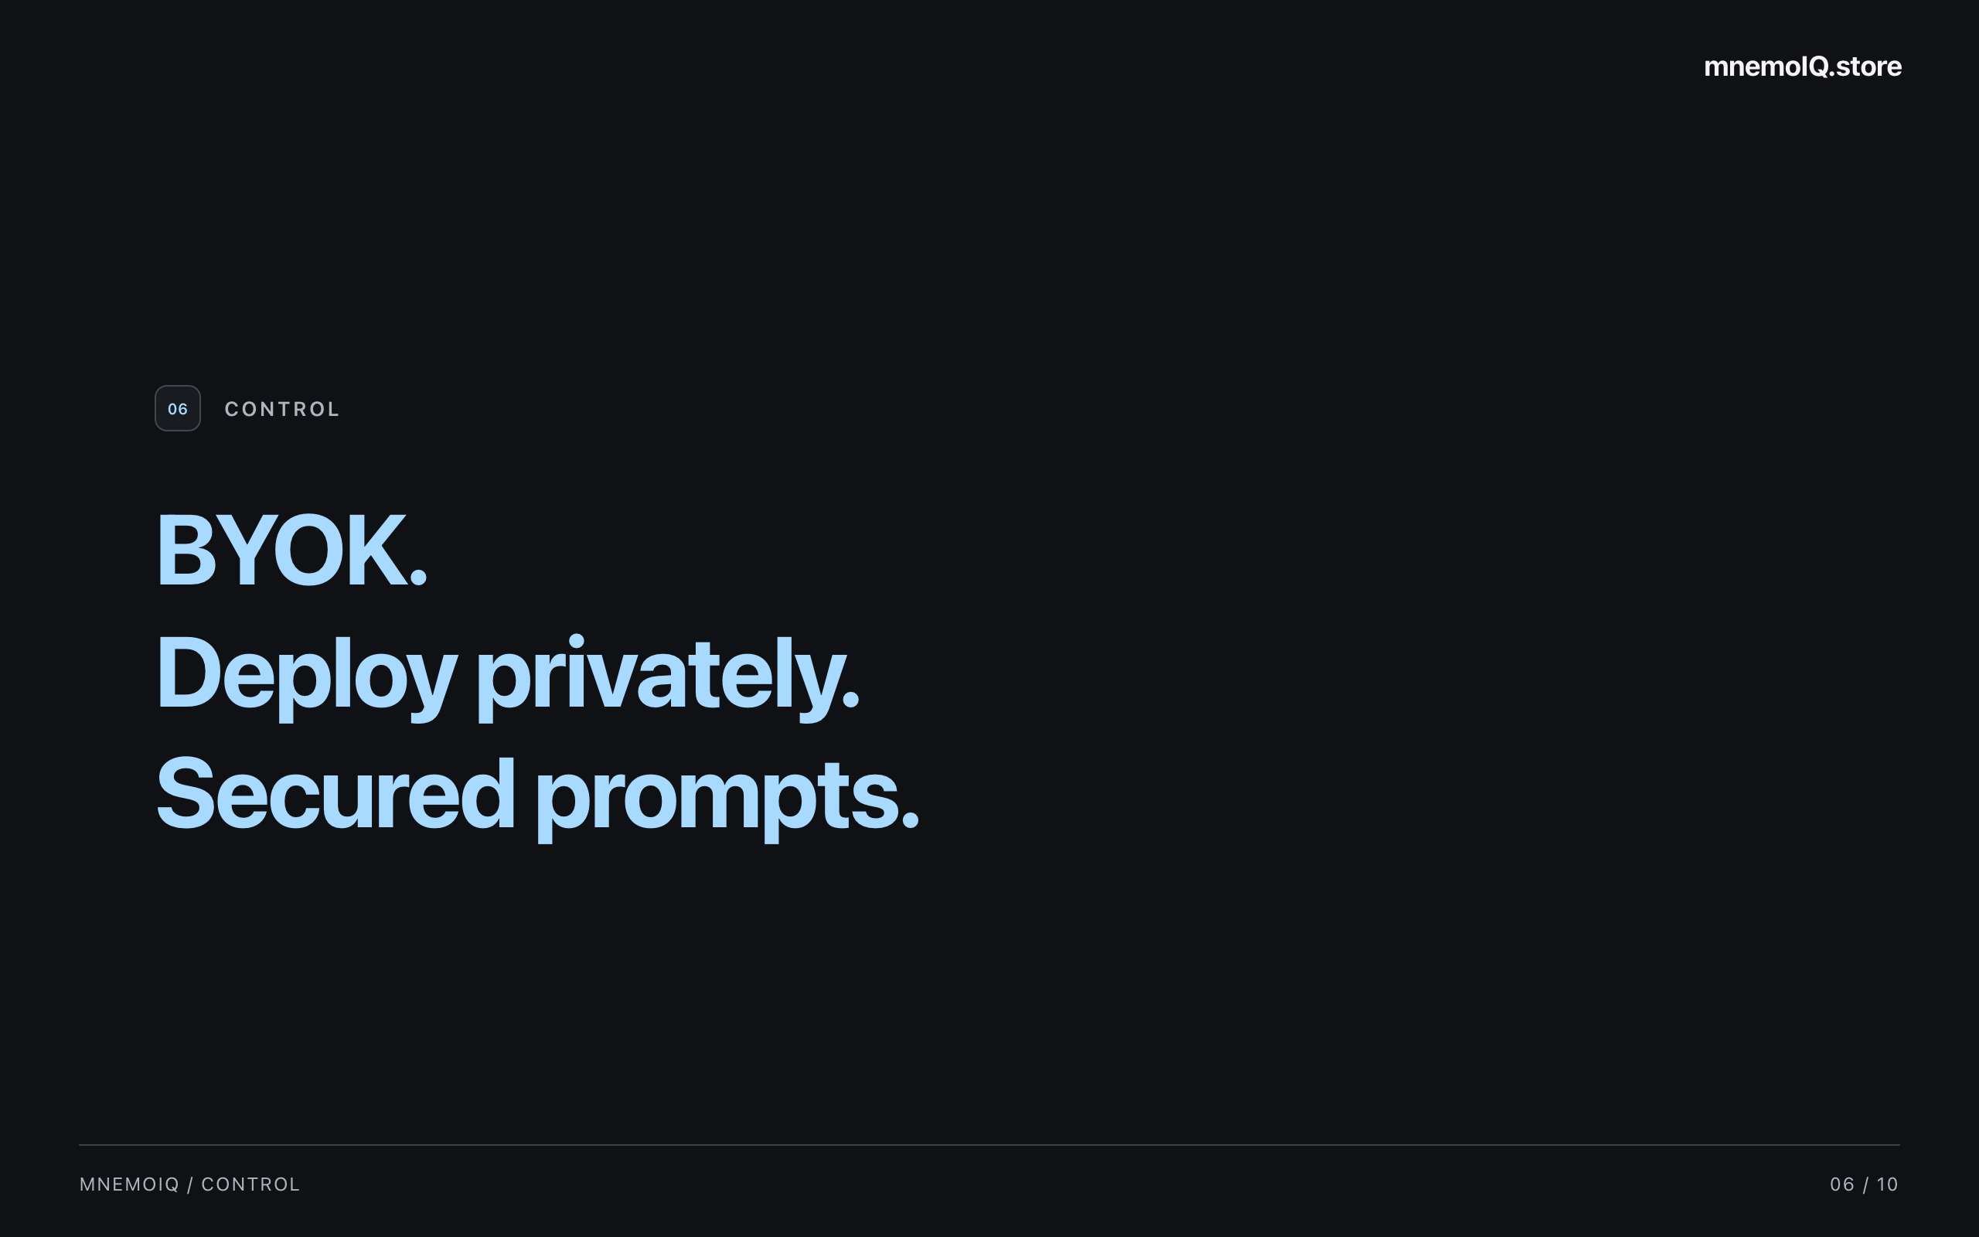
Notes:
BYOK means bring your own key. Teams can use their chosen provider credentials and deploy privately. Secured prompts are part of the control story. Discuss the deployment and access settings that fit the team. The next slide brings the main differentiators together.

Slide 7
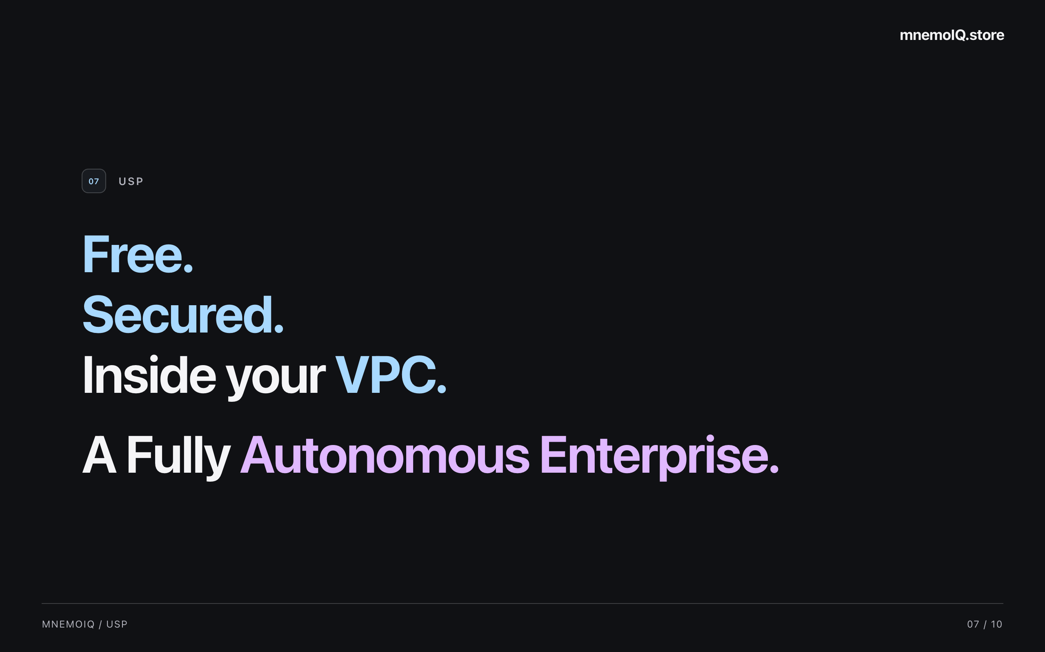
Notes:
Our USP means our unique selling proposition: free, secured, and inside your VPC. A VPC is your own private cloud environment. These are the three points to remember about mnemoIQ. Pause after each point, then introduce the founder.

Slide 8
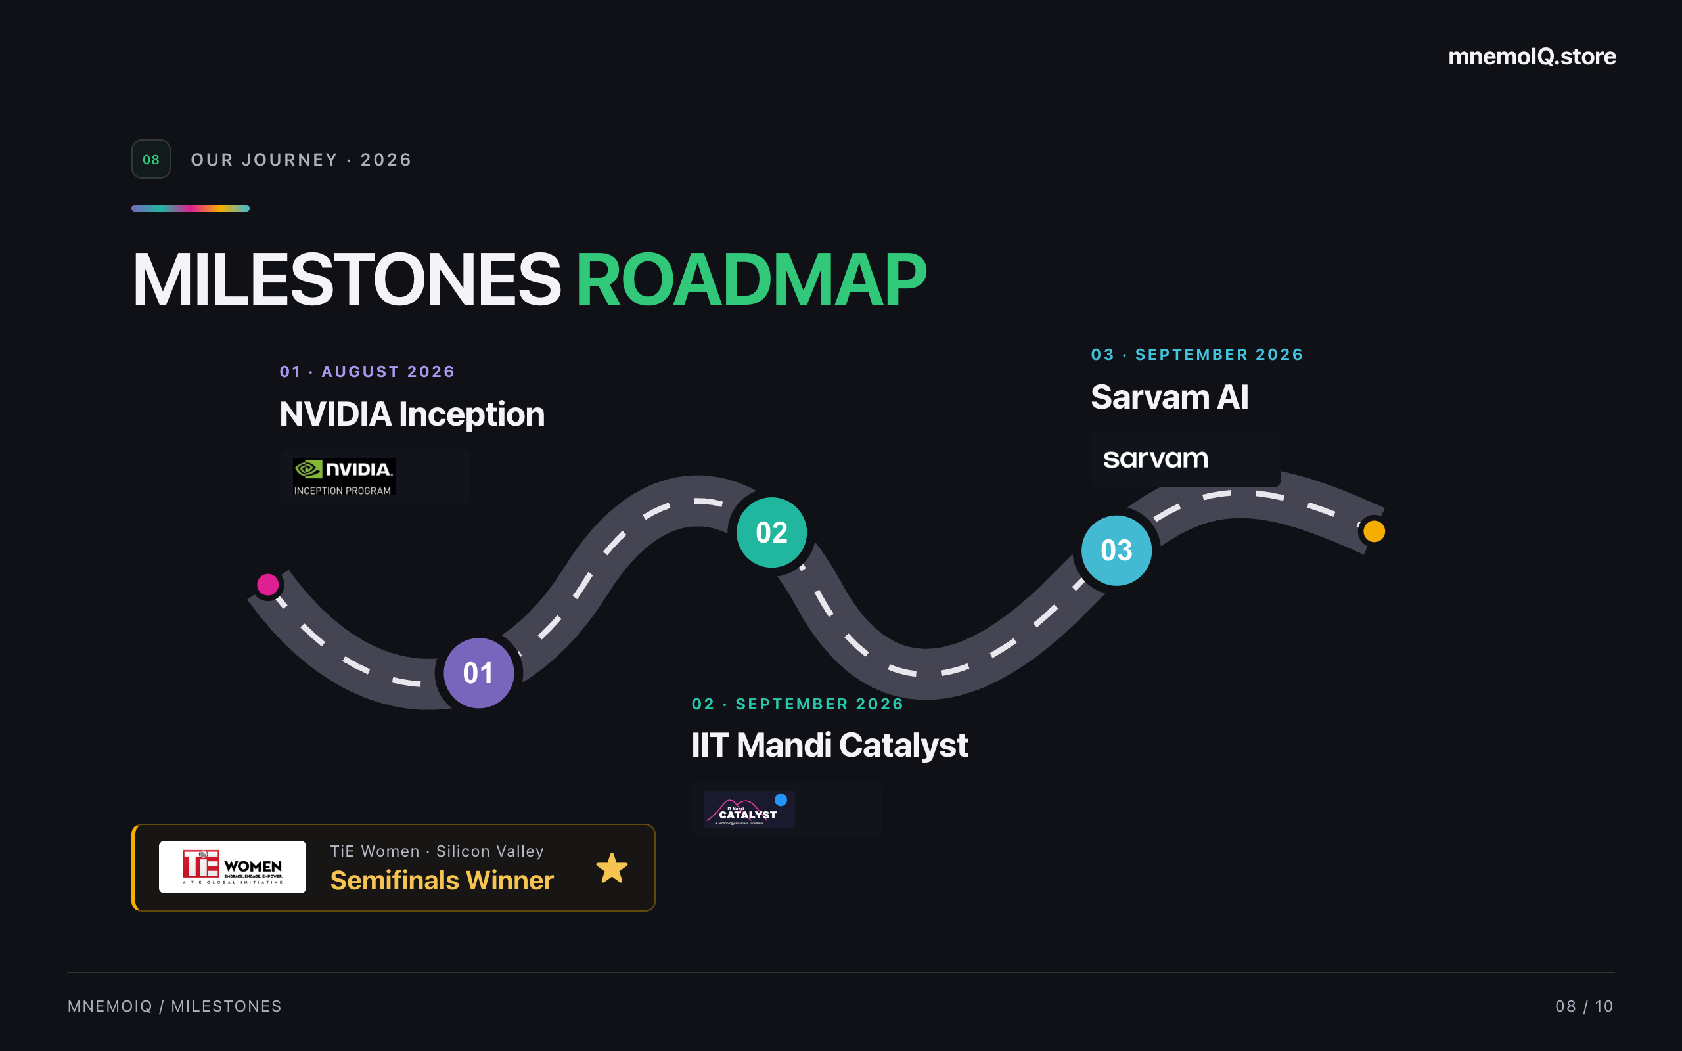
Notes:
Our milestones began with NVIDIA Inception in August 2026, followed by IIT Mandi Catalyst and Sarvam AI in September 2026. These mark the next steps in the mnemoIQ journey. mnemoIQ also won the TiE Women Silicon Valley semifinals. Now, meet the founding team.

Slide 9
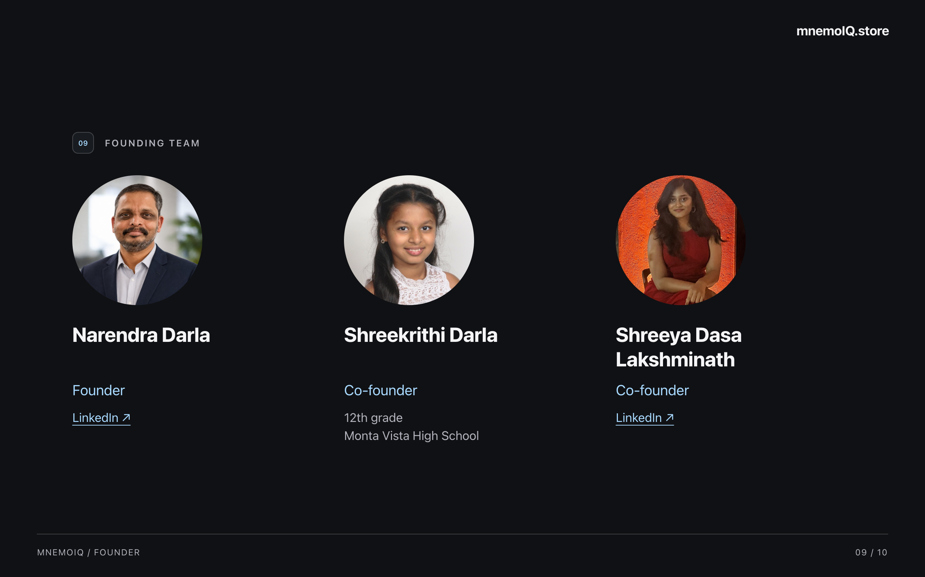
Notes:
I am Narendra Darla, founder of mnemoIQ. Our co-founders are Shreekrithi, a 12th-grade student at Monta Vista High School, and Shreeya Dasa Lakshminath. Introduce each team member, then invite the audience to try mnemoIQ. The LinkedIn links open Narendra’s and Shreeya’s profiles.

Slide 10
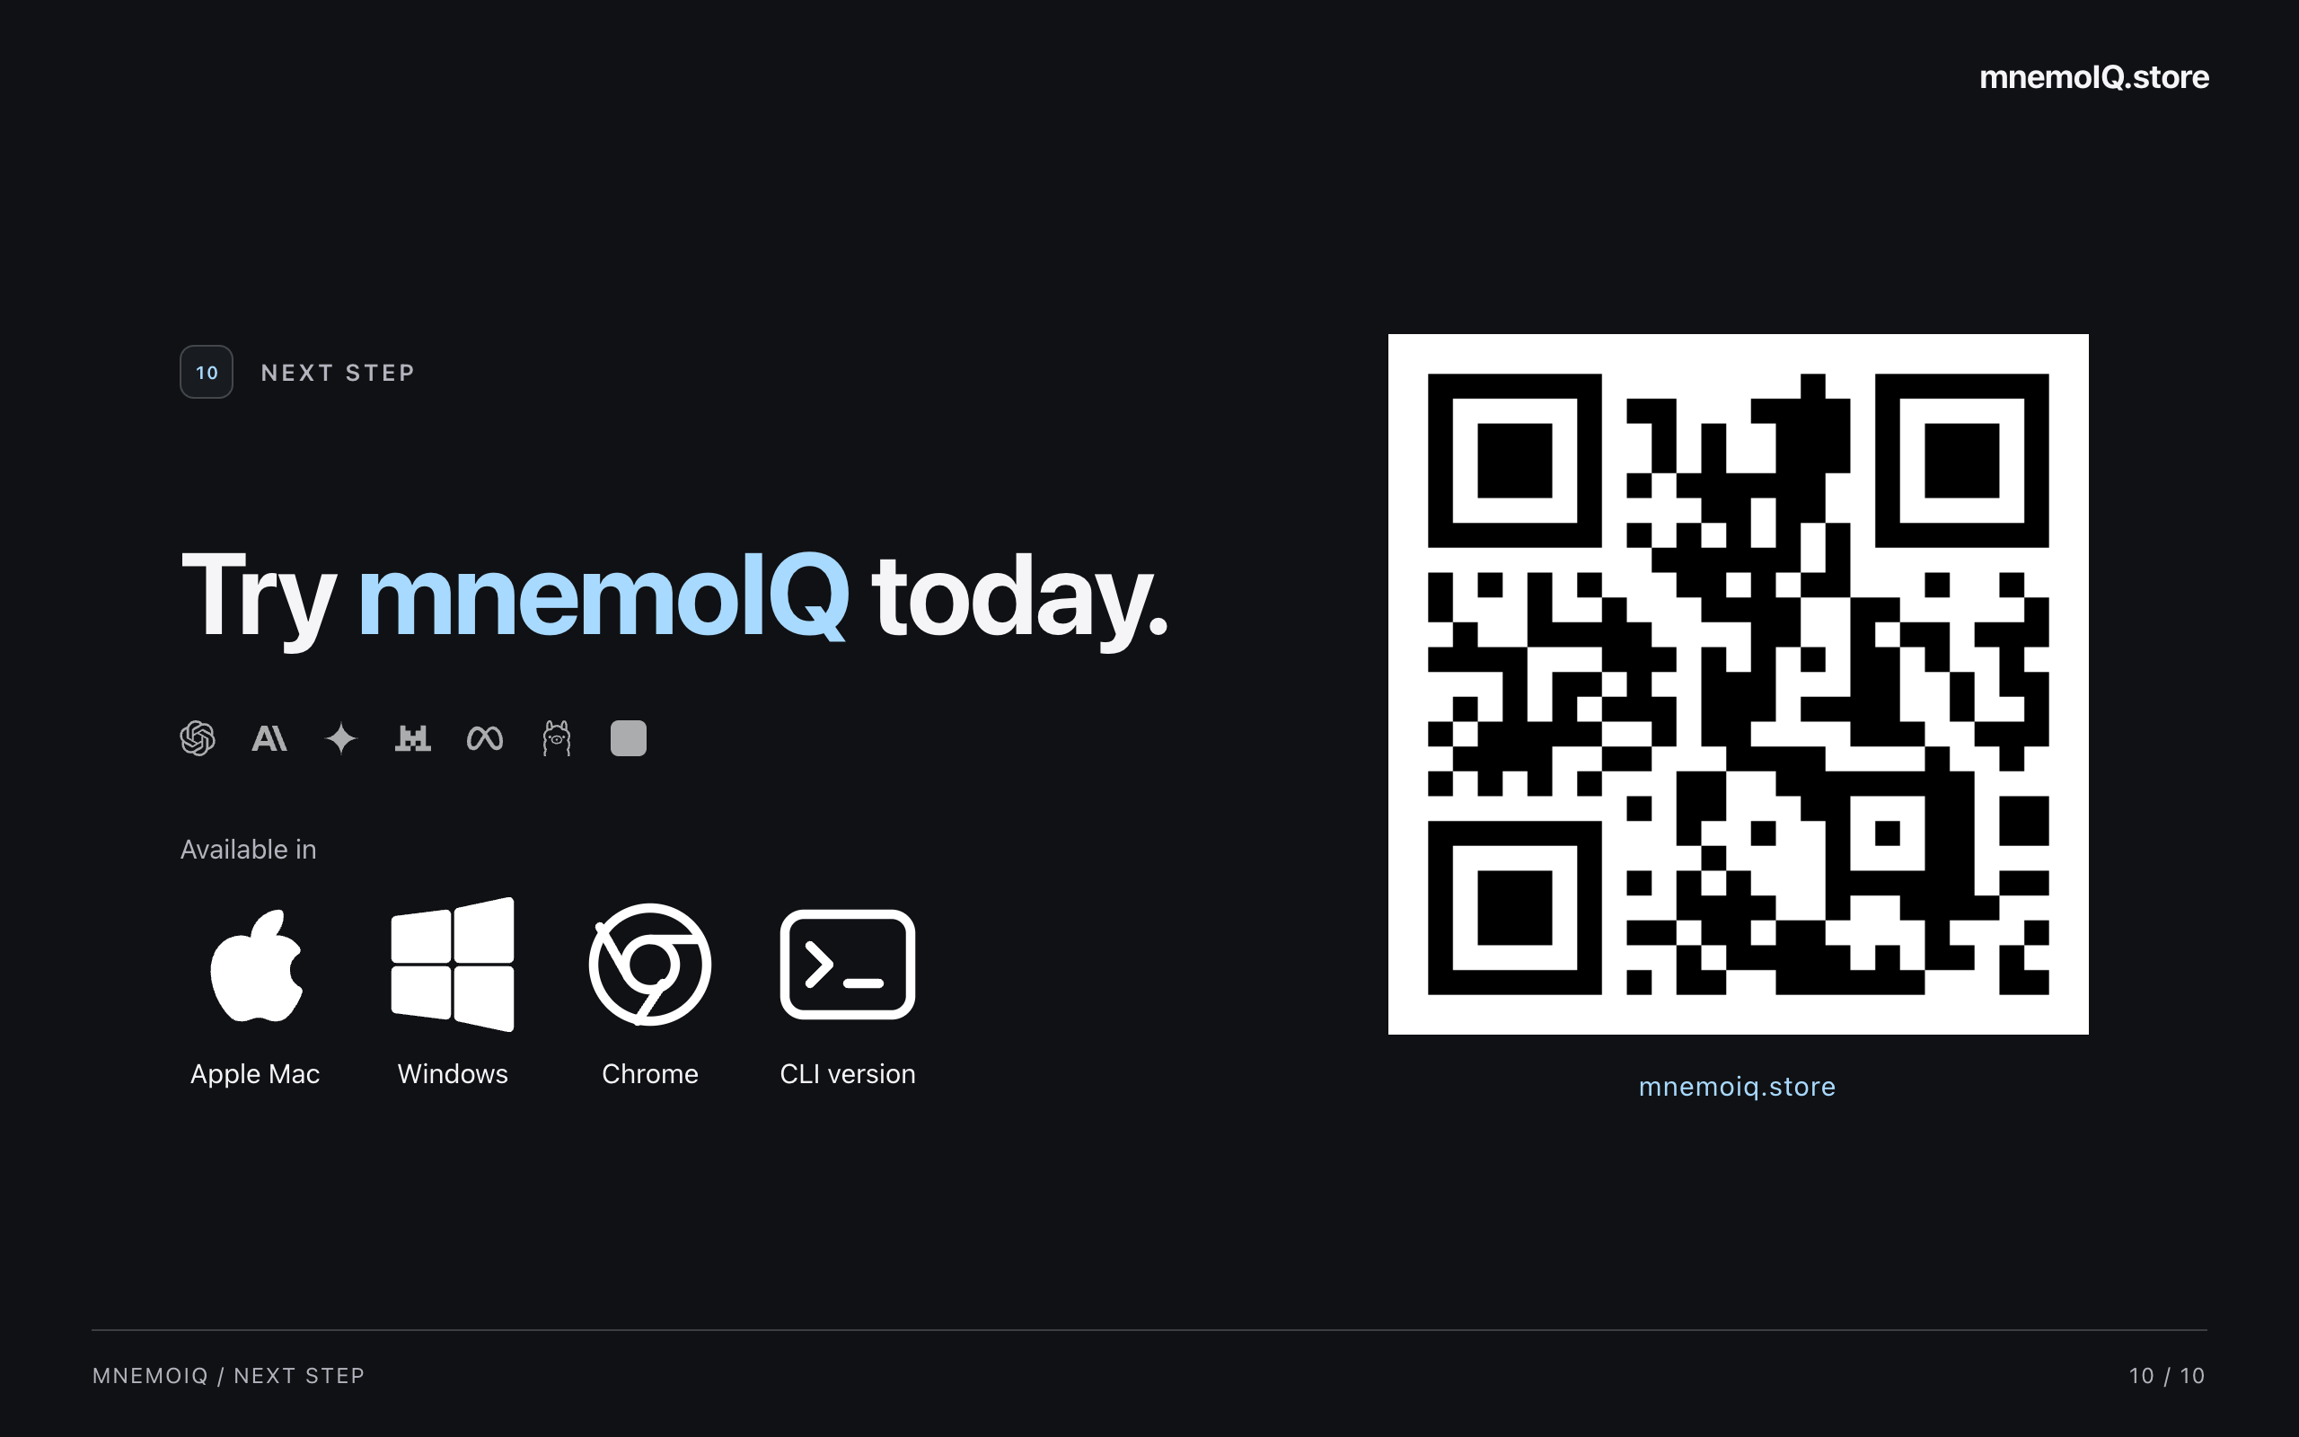
Notes:
Try mnemoIQ at mnemoiq.store, or scan the QR code. It is available for Apple Mac, Windows, Chrome, and the CLI. Choose the version that fits your workflow. Invite the audience to try it with a real question from their work, then pause for questions.

